Slide 1
Electrical & Computer Engineering Department Ryerson University
EDP Topics of Xavier Fernando - 2014

Slide 2
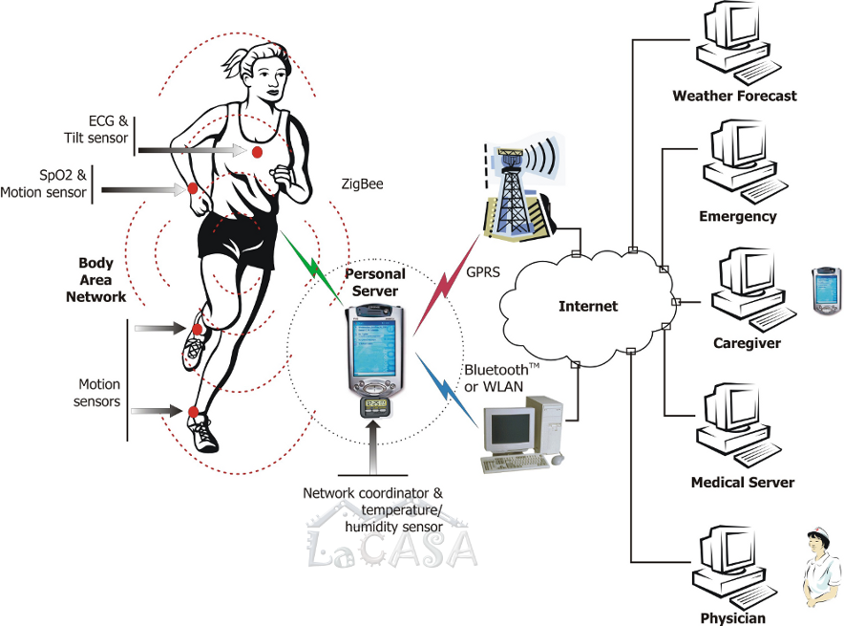
Body Area Wireless Sensor Networks

Slide 3
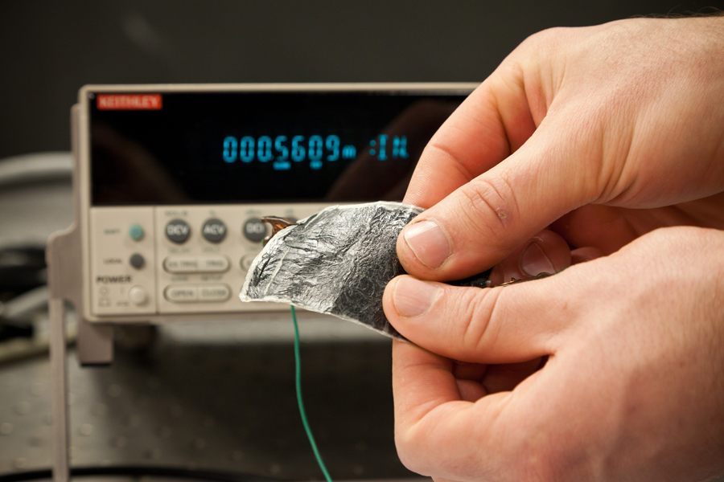
Energy Harvesting
There will be large number of sensors
Small batteries frequently run out
Replacing them is a chore
Powering these sensors can be a major issue
In this project, we will investigate how to generate enough electricity from our body heat and store it in super capacitors or rechargeable batteries to power the wireless sensor nodes

Slide 4
Design of Personal Server
Another project is designing the personal server that will:
Collect data from the body sensors
Suggest the appropriate exercise
Keep track of the medical history
Keep track of exercise history
Communicate with the exercise equipment and convey the physical condition of the user

Slide 5
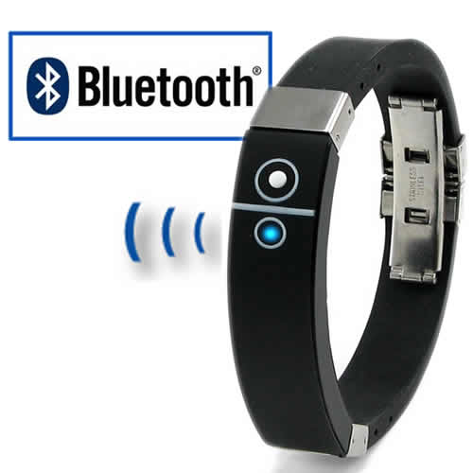
Personal Security Device
Personal attacks are on the rise
Often too fast to trigger a safety device
In this project, students are expected to design an easy to trigger personal security device that is paired with a cell phone App.
In an emergency situation, the cell phone will be alerted instantly and it will take appropriate action to save the victim.

Slide 6
Collaborative Robots for Simple Tasks
Many tasks require multiple mobile robots (search & rescue…)
They should establish a reliable wireless communication link.
They should accomplish a task together by communicating with each other in a collaborative manner.
They should perform complimentary actions, not identical actions.
The distance between them could be from few cm to few tens of meters.
Other goals are cost reduction, low power operation and circuit simplicity.

